Slide 1
September 5th Meeting
Ainsley Lai

Slide 2
Agenda
Identifying MMSI’s that are close to a hydrophone and have a wider speed range
  Amount of data and wide date range
Transferring Results

Slide 3

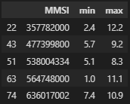
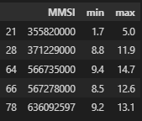
Identified MMSI
Within 7km from a hydrophone
Possess a speed range of at least 3 knots
EC
CC
AB

